Slide 1

Lawgorithm: Multi Agent Legal Research Companion

Slide 2

Agenda
Problem Statement
Proposed Solution
Architecture Diagram
Implementation
Results
Demo

Slide 3
Problem Statement
Legal research is fundamental to law education, often starting with a base paper such as a landmark judgment or academic article and expanding into supporting material for new or divergent arguments. However, the process remains manual and time consuming, involving repetitive keyword searches, citation tracing, and switching across platforms. Existing tools offer little contextual support, lack intelligent citation chaining, and depend heavily on user input. As a result, students often miss critical sources that could enhance their arguments and legal reasoning.

Slide 4
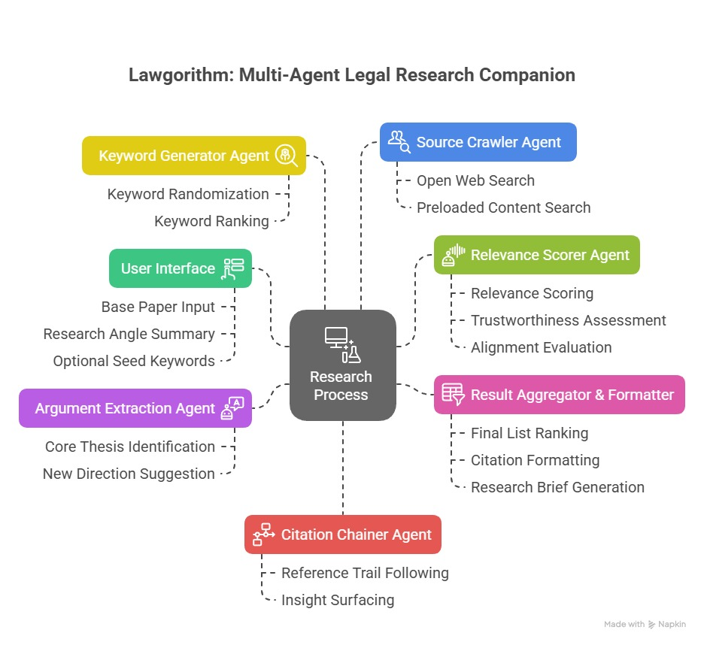
Architecture Diagram

Slide 5
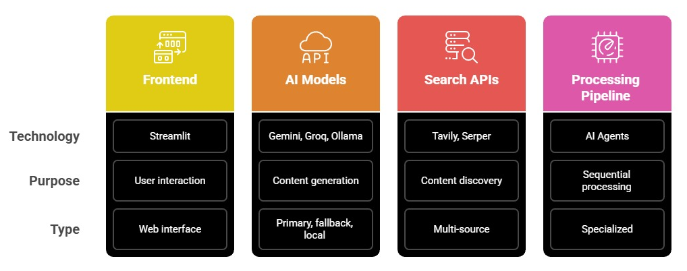
Core Components

Slide 6
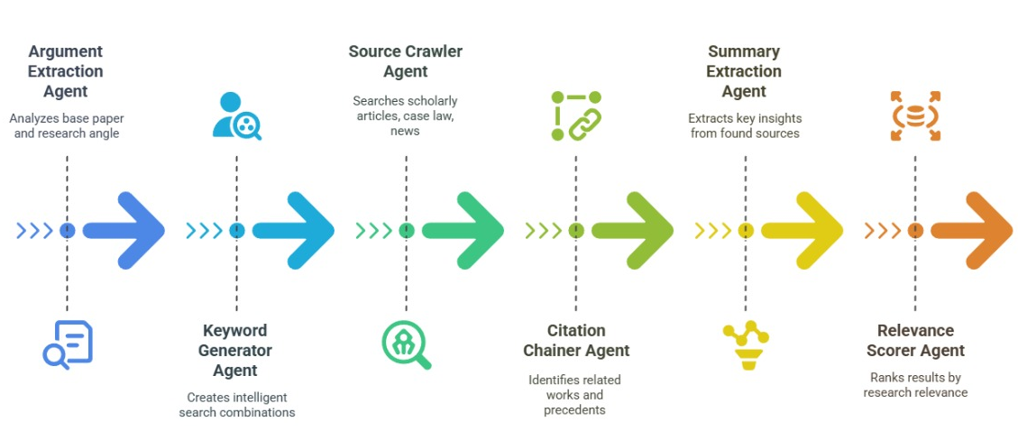
Agent Workflow Sequence

Slide 7
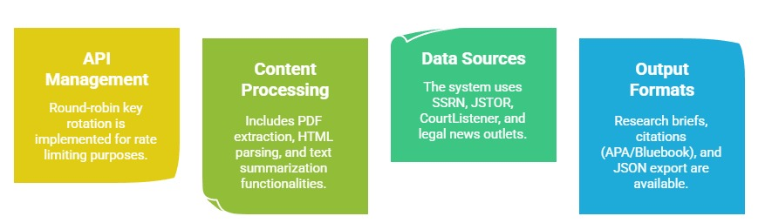
Technical Implementation

Slide 8
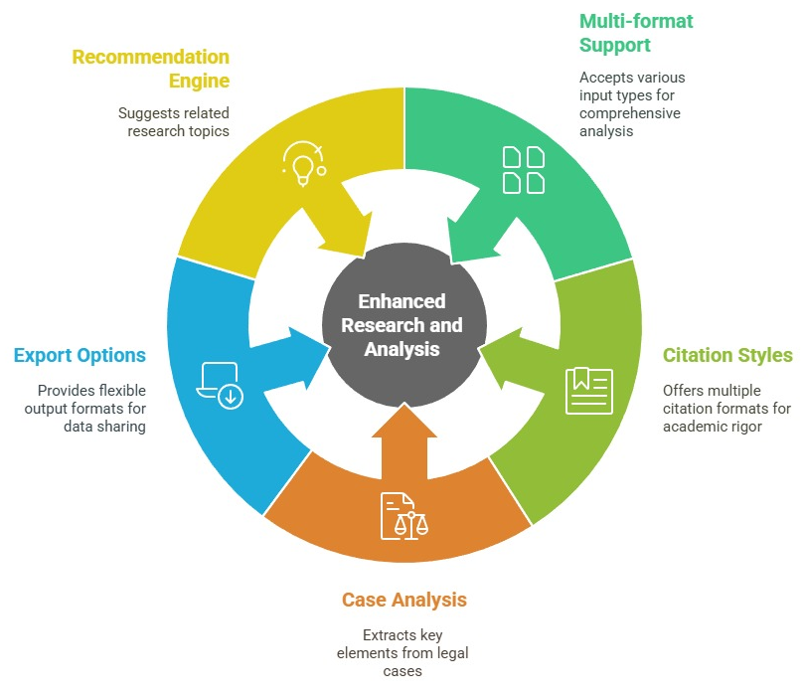
Features Enhancing Research and Analysis

Slide 9
Thank you

